Slide 1
Implementing Reaver in Parallel
Multicore Processors with Prof. Mohamed Zahran
Thomas Mason & Kabir Singh

Slide 2
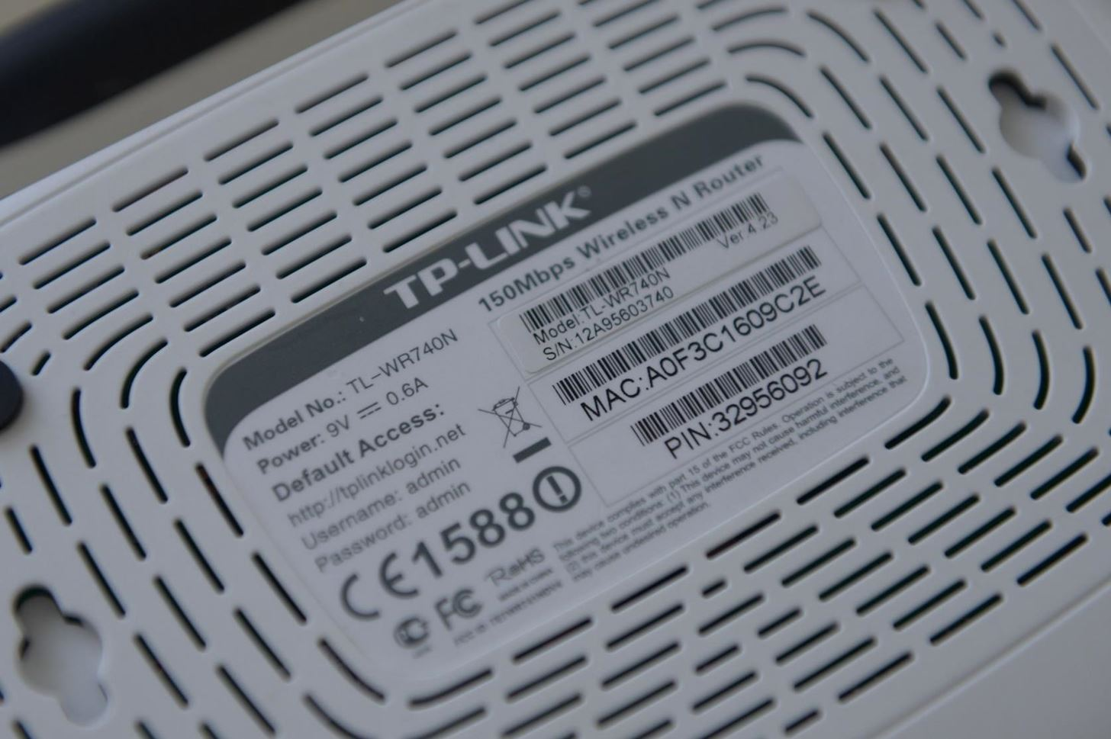
WPA2 & WPS
WPA2 works by using a 4-way handshake. This is breakable if you have a password cracker (aircrack-ng).
However, takes time – strong passwords will usually be safe
WPS – exploits a vulnerability in Wireless Protected Setup PIN number
If a WPS PIN is enabled, an attacker can launch a much faster attack
Checks a 4-digit and a 3-digit numeric pins – needs to brute force 10^3 + 10^4 = 11,000 combinations.
Can do this while monitoring a network in an online attack

Slide 3
Our Setup
aaa

Slide 4
Results
ttt
Threads | 1 | 2 | 4 | 10
AVG | 0.45s | 0.28s | 0.26s | 0.32s
SPEEDUP | 0% | 62% | 71% | 45%

Slide 5
Conclusions
Botnets & why its fucked
New hardware security – old tool

